Slide 1

EL Instructional Academy
Karina E. Chapa, M.Ed.
Language Proficiency, Biliteracy and Cultural Diversity Director
kchapa@esc1.net
Twitter @esc1bilingual @bilingualpride

Slide 2

Intellectual Property Statement
All materials, content, and forms contained in this training/presentation are the intellectual property of the Region One Education Service Center and are intended for use by session participant at the classroom, campus, or district level only. Materials are to be used “as is” without modification.
Materials may not be used for personal benefit or financial gain or for use outside of the school system.
www.esc1.net│facebook.com/RegionOneEducationServiceCenter│twitter.com/RegionOneESC

Slide 3

Professional Learning Essential Agreements
Be respectful of others
Be an active participant
Take care of your needs
Use electronic devices as learning tools

Slide 4

What do you remember from yesterday?

Slide 5
AGENDA
TELPAS-ELPS Connection
ELPS LIAG and ELPS Tool
LPAC Procedures
Second Language Acquisition

Slide 6
Five SLA Hypothesis
Acquisition vs Learning Hypothesis
Monitor Hypothesis
Natural Order Hypothesis
Input Hypothesis
Affective Filter Hypothesis

Slide 7
Expert Jigsaw: Tree Map
Krashen’s Five Hypothesis
Learning vs Acquisition
Monitor
Natural Order
Input
Affective Filter

Slide 8
Telpas-elps connection

Slide 9
Session Objectives
Content Objective
Today I will examine how to implement the ELPS in all content areas and how to analyze TELPAS data to guide instruction. I will also review the LPAC process to make decisions impacting ELL instruction.
Language Objective
Today I will share (orally and in writing) different ideas on how to linguistically accommodate instruction with the ELPS based on TELPAS results and the role of the LPAC in this process.

Slide 10

ELPS
Anticipation Guide
kahoot.it
create.kahoot.it

Slide 11
Statutory Requirement
19 Texas Administrative Code 74.4 Chapter 74. Curriculum Requirements Subchapter A. Required Curriculum 74.4 English Language Proficiency Standards
Adopted December 2007

Slide 12
ELPS: How are they organized?
Big Ideas
1. Make Content Comprehensible
2. Develop Academic Language
Big Responsibilities
1. Communicated
2. Sequenced
3. Scaffolded
Student Expectations
1. Listening
2. Speaking
3. Reading
4. Writing
5. Learning Strategies
PLDs (L, S, R, W)
1. Beginning
2. Intermediate
3. Advanced
4. Advanced High

Slide 13
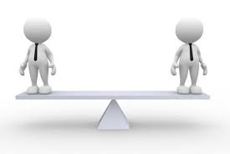
Academic + Linguistic Proficiency
STAAR
TELPAS
T
E
K
S
E
L
P
S

Slide 14
TEKS vs ELPS
Academic Proficiency Language Proficiency
STAAR
TELPAS
TEKS
ELPS
Relating Factor: evaluates/measures

Slide 15
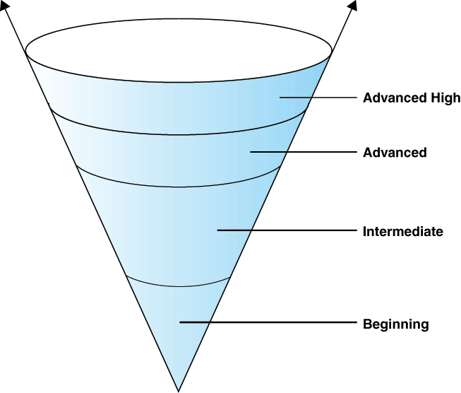
TELPAS Levels

Slide 16
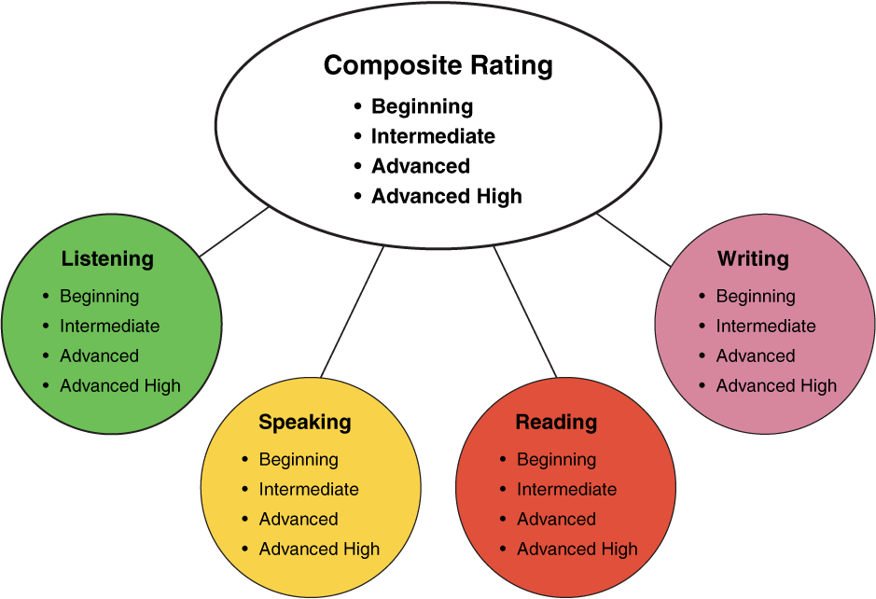
TELPAS Domains
25%
25%
10%
30%
25%
25%
10%
50%
2nd-12th Online

Slide 17


ELPS Resources
LIAG and ELPS Instructional Tool
+
DMAC Reports

Slide 18
ELPS Mingle!
  Listening PLDs
  Listening Expectations & CCRS
  Listening Teacher Behaviors
  Speaking PLDs
  Speaking Expectations & CCRS
  Speaking Teacher Behaviors
  Reading 2-12 PLDs
  Reading Expectations & CCRS
  Reading Teacher Behaviors
  Writing 2-12 PLDs
  Writing Expectations & CCRS
  Writing Teacher Behaviors

Slide 19
DMAC TELPAS Reports
How to Run TELPAS Reports by Language Domain
Go to Home Page
Go to State Assessment
Select TELPAS
Select Instructional Reports
Select Student Language Proficiency Rating
Generate Report

Slide 20
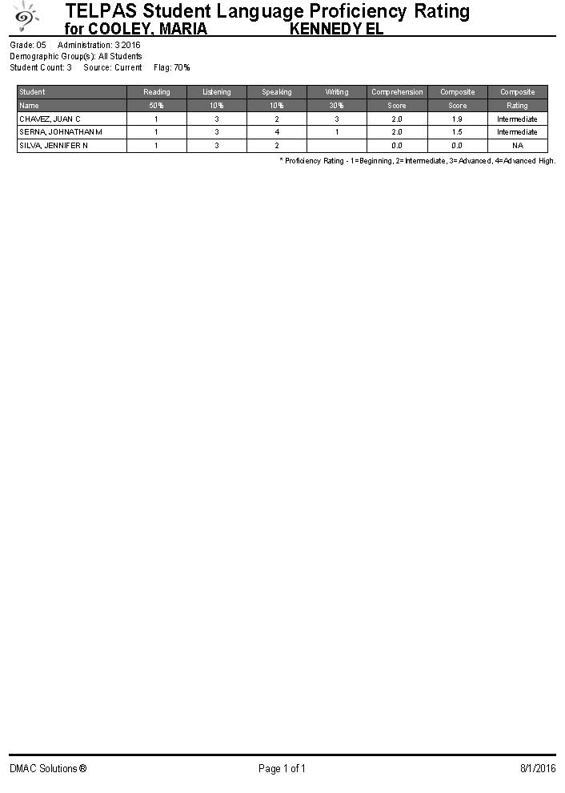
Sample DMAC Report

Slide 21
ELPS Online Trainings
Go to: www.texasgateway.com
Sign Up: Create an account
Search: ELPS
Complete course

Slide 22
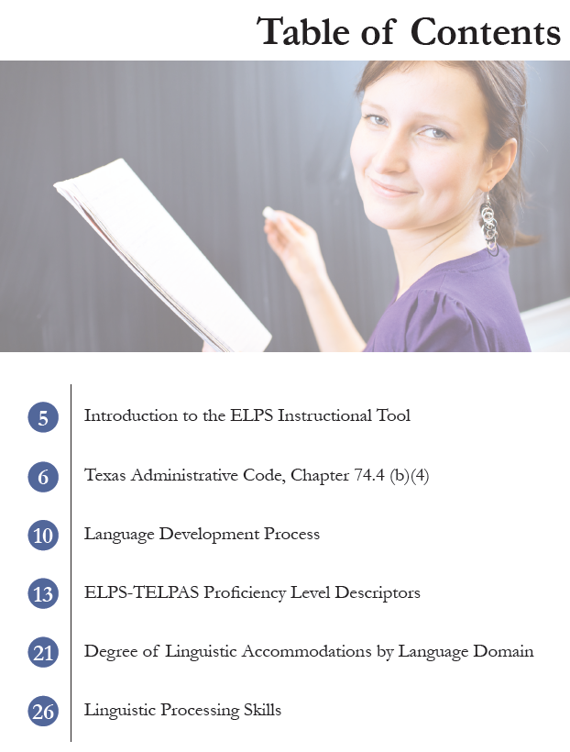
ELPS Instructional Tool
Meeting the needs of beginning and intermediate ELs

Slide 23
TAC, Chapter 74.4 (b) (4)
… provide intensive ongoing foundational second language acquisition instruction to ELLs in Grade 3 or higher who are at the beginning or intermediate level of English Language proficiency in listening, speaking, reading and/or writing as determined by the state’s English language proficiency assessment system.

Slide 24
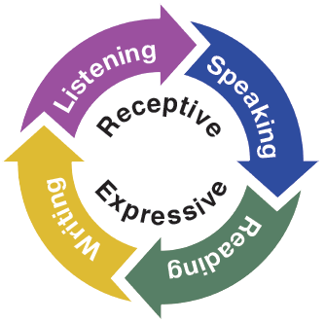
Second Language Acquisition
ELPS Instructional Tool
Instruction must be focused, targeted, and systematic

Slide 25
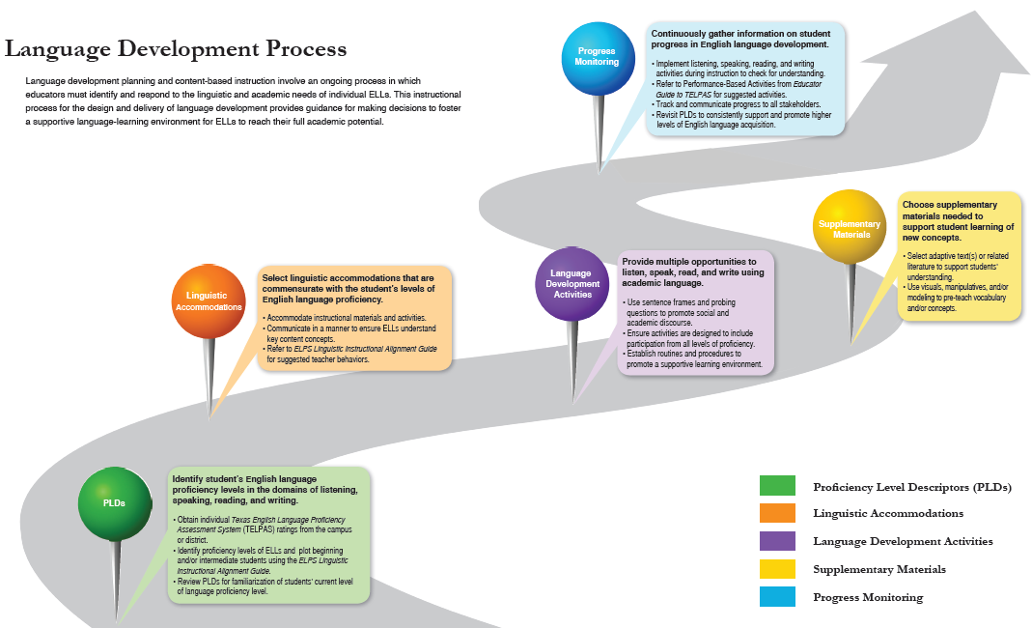
Emojis

Slide 26
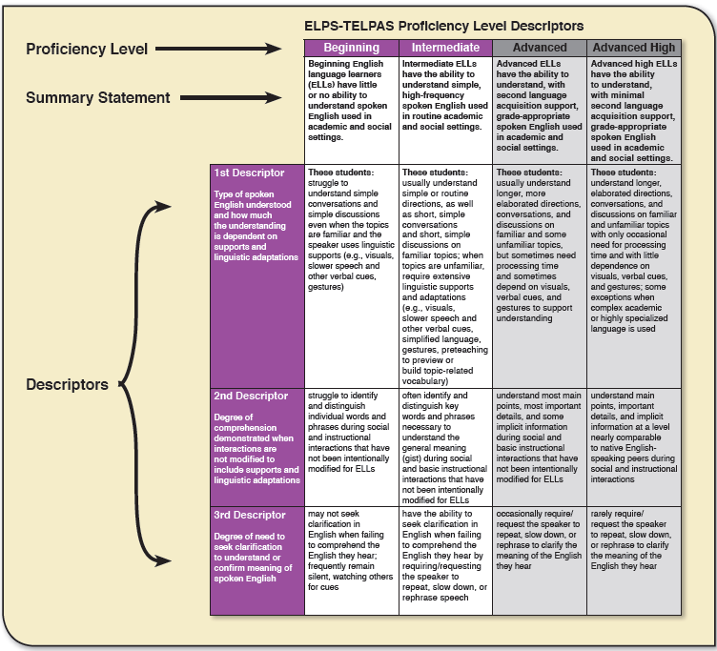
Inside Outside Circle

Slide 27
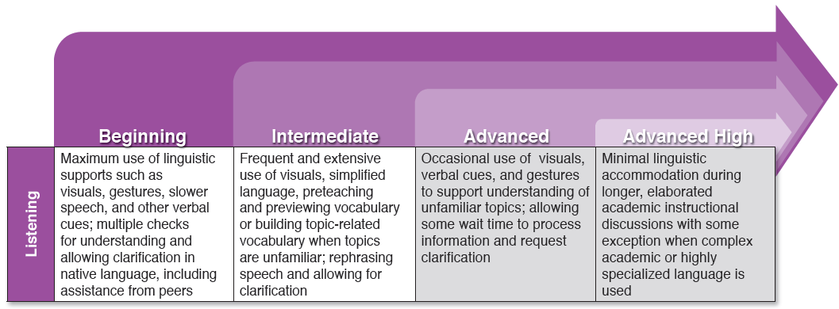
Degree of Linguistic Accommodations by Domain

Slide 28
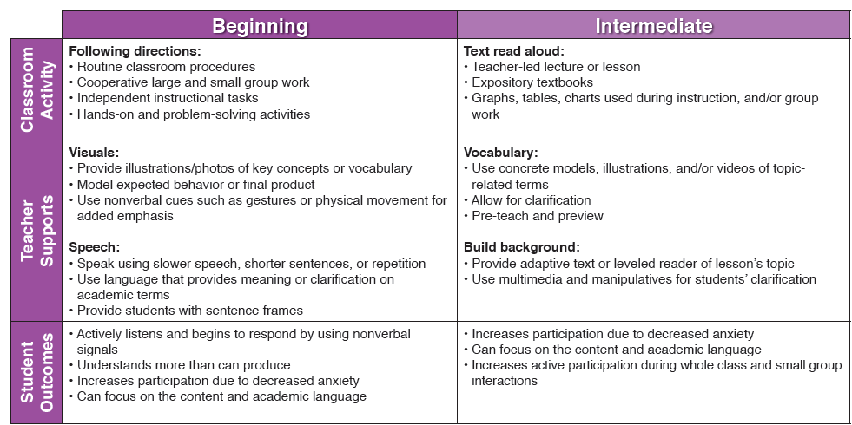
Degree of Linguistic Accommodations by Domain
Think Pair Share

Slide 29
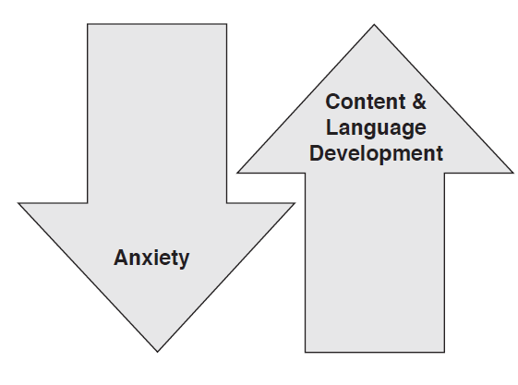
Linguistic Processing Skills
Sentence frames provide students with the means to receive and express language while reducing their anxiety.
Levels of content and language development will increase as students do not have to contend with context, grammar, and syntax simultaneously.
Tool, pages 28-33

Slide 30

Providing Comprehensible Input
https://projects.esc20.net/page/lpac_resources

Slide 31

Blah School
Teacher
Student
This Photo by Unknown Author is licensed under CC BY-NC

Slide 32
General Ed

Slide 33
Bilingual Education
ESL
Permission
Permission
General
Education
General
Education
No
Bil Services
Monitoring
No
ESL Services
TELPAS
assessment
Two

Slide 34
EL Reclassification Criteria

Slide 36

The Danger of a Single Story
https://www.youtube.com/watch?v=D4pH6TxKzus

Slide 37
Session Objectives
Language Objective
Today I shared (orally and in writing) different ideas on how to linguistically accommodate instruction with the ELPS based on TELPAS results and the role of the LPAC in this process.
Content Objective
Today I examined how to implement the ELPS in all content areas and how to analyze TELPAS data to guide instruction. I also reviewed the LPAC process to make decisions impacting ELL instruction.

Slide 38

Tickets Out
I used to think…
But now I know…

Slide 39
Thank you!
See you tomorrow!
Karina E. Chapa, M.Ed.
Language Proficiency, Biliteracy and Cultural Diversity Director
kchapa@esc1.net
Facebook: Region One ESC Bilingual
Twitter @esc1bilingual @bilingualpride

